Slide 1

Project on
CUSTOMER RETENTION
By
Balu Gumidelli
This Photo by Unknown Author is licensed under CC BY

Slide 2
SUMMARY:
This study explores the nature of customer relationships in e-retail in India. With the advent of fast and speedy internet services along with smartphone penetration India is in the middle of an e-commerce boom right now with more and more shopping websites and a world to choose from for a regular online shopping customer. In such a scenario it becomes extremely important to understand the nature in which a customer is approaching to this sudden wave of online shopping and accordingly try and customize and build your business so as to differentiate yourself from herd.
The motivation behind this study was to speed up the road to profitability of the horde of
E-commerce websites by a deeper understanding of customers and their patterns while shopping online.

Slide 3
Contents:
Introduction
Problem Statement
Problem Understanding
What is Customer Retention?
Importance of Customer Retention
Exploratory Data Analysis
Visualizations
Conclusion

Slide 4
Introduction
The aim of this study is basically to deal with customer relationships in e-retail in India and how customer retention as a strategy can be looked as a potential untapped marketing management strategy for the internet retailers in India.
With growing Internet penetration and more retailers looking to venture online it becomes necessary to see the possible framework which will increase loyalty ,retain customers and develop relationships beyond pure transactional and financial.
In this presentation we will be looking at the analysis made on the customer retention rate for Indian e-commerce companies.
We will be analysing the customers retention rate and e-commerce success rate with the help of a survey answered by the customers.
This analysis includes the expectations, reliability, trustworthiness etc of the customers.

Slide 5
PROBLEM STATEMENT
Customer satisfaction has emerged as one of the most important factors that guarantee the success of online store; it has been posited as a key stimulant of purchase, repurchase intentions and customer loyalty. A comprehensive review of the literature, theories and models have been carried out to propose the models for customer activation and customer retention. Five major factors that contributed to the success of an e-commerce store have been identified as: service quality, system quality, information quality, trust and net benefit. The research furthermore investigated the factors that influence the online customers repeat purchase intention. The combination of both utilitarian value and hedonistic values are needed to affect the repeat purchase intention (loyalty) positively. The data is collected from the Indian online shoppers. Results indicate the e-retail success factors, which are very much critical for customer satisfaction.

Slide 6
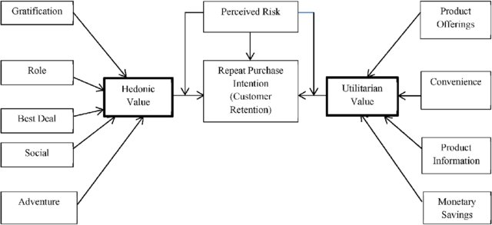
Utilitarian value:
Utilitarian value is an objective value which provides some functional benefits to the consumers and helps consumers to accomplish practical tasks.
Hedonistic value:
Hedonistic value is subjective (Psychological) value which provides an experiential satisfaction. In other words, the immediate psychological gratification that comes from experiencing some activity or from consumption of a product

Slide 7
Problem Understanding :
The problem statement examined how customers form expectations on technology based self-service quality and suggested five main attributes of ecommerce store quality, that are service quality, system quality, information quality, trust and net benefit.
Many businesses focus on customer loyalty programs to remain competitive in today's marketplaces and explore innovative ways to keep their existing customers engaged. Customer retention is a simple concept. Yet, it often requires effort from every department to improve the customer experience and build lasting trust. So, what is customer retention and why it is so important. Let’s know about it by analysing the problem.

Slide 8

What is Customer Retention?
Customer retention refers to the rate at which customers stay with a business in a given period of time. This is often referred to as churn rate and is a key metric for practically all B2B and B2C businesses. In general, the lower the churn, the more loyal the customers and more successful the business, as the business retains more customers over time.

Slide 9
Importance of Customer Retention:
It's also easier and more cost-effective to retain customers than to acquire new ones, returning customers spend more and buy more often, and refer friends and family. Only a 5% increase in customer retention can increase company revenue by 25-95%.
The numbers don't lie: Retaining customers brings companies a ton of ROI.
There are a few reasons why customer retention is critical to company growth and success:
Affordability: It's 6 to 7 times more expensive to acquire a new customer than it is to retain an existing customer.
ROI: A 5% increase in customer retention can increase company revenue by 25-95%.
Loyalty: Retained customers buy more often and spend more than newer customers. They've learned the value of a product or service and keep coming back, again and again.
Referrals: Satisfied, loyal customers are more likely to sing a company's praises and refer their friends and family — bringing in new customers, free of charge.
It might seem obvious — of course, companies should want to retain customers — but when companies start growing quickly and struggle to implement a solid customer support program, proactive customer support for existing customers can slip through the cracks.

Slide 10
Exploratory Data Analysis:
After importing the data set, I’ve checked the shape, value counts, info and null values in the data set.
Then while looking into the value counts I found some duplicate entries in the features i.e., two words with same meaning. I have replaced those duplicates by grouping them.
I ‘ve renamed the columns for better understanding.

Slide 11

VISUALIZATIONS

Slide 12
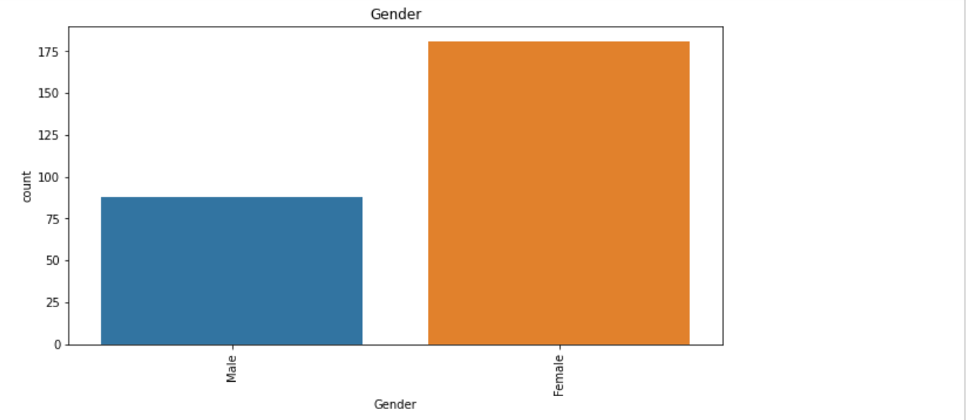
VISUALIZATIONS
Observations:
From the count plot we can clearly see that the female customers are more than Male customers.

Slide 13
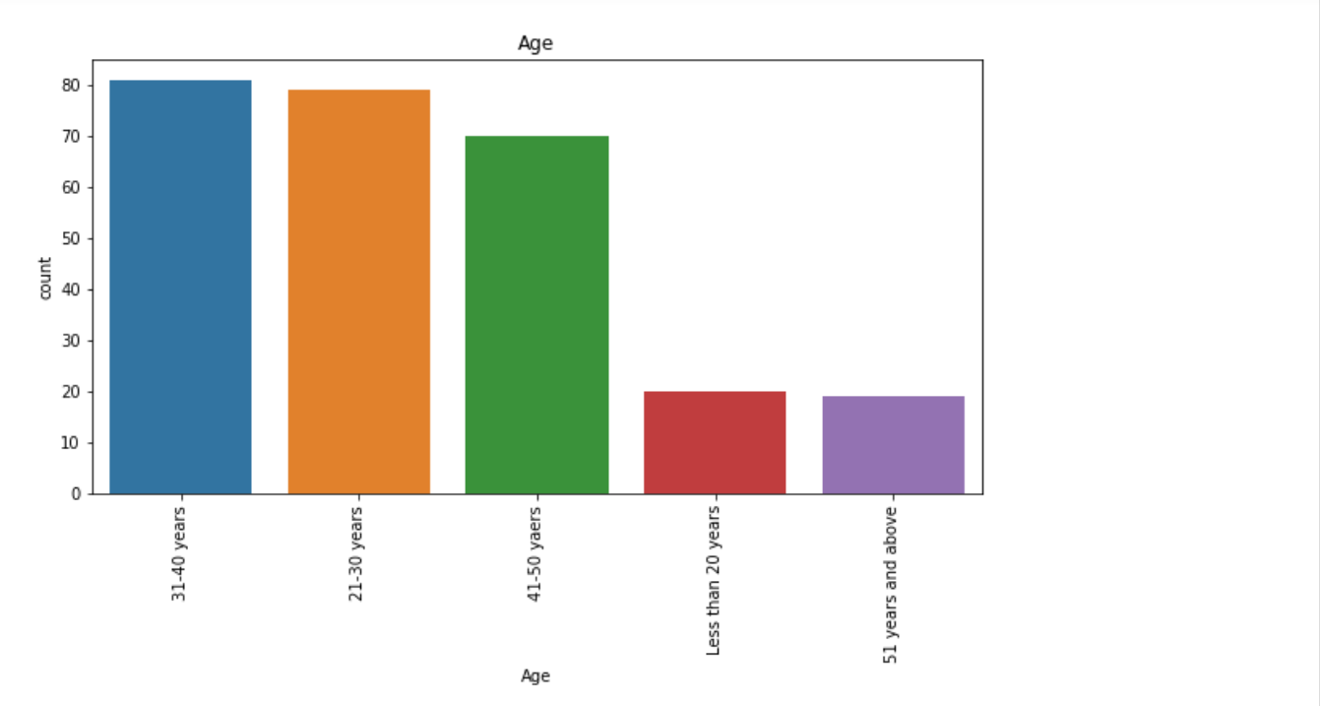
OBSERVATIONS:
This count plot shows that 21 to 30 & 31- 40 years Old shops more and 51 years above shops less.

Slide 14
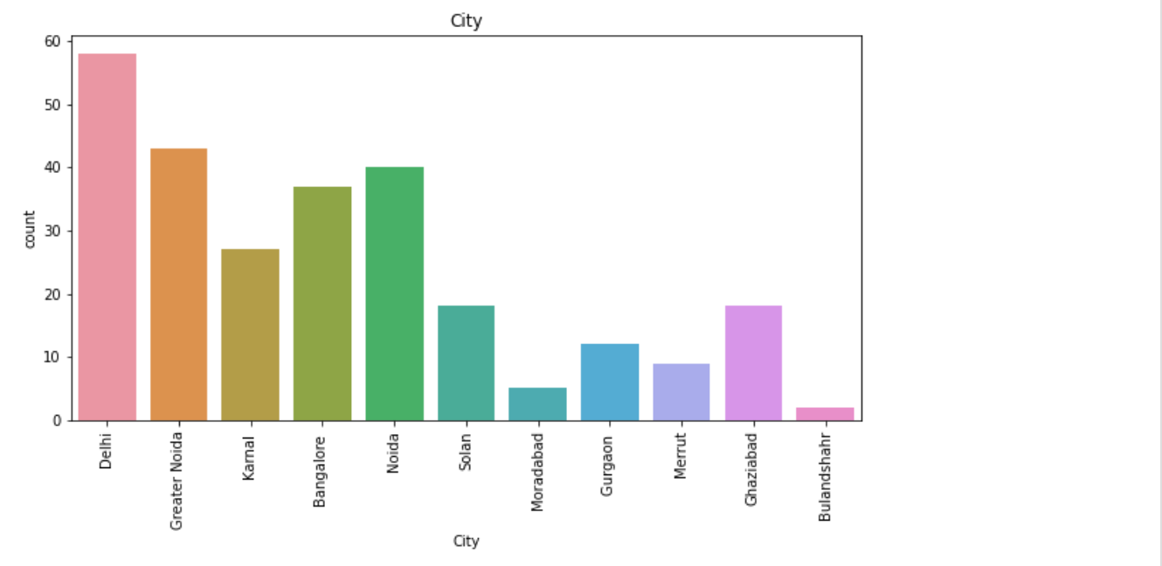
Observations:
This Visualization shows the count of online customers
according to the city.
We can observe that Delhi has maximum count of customers.

Slide 15
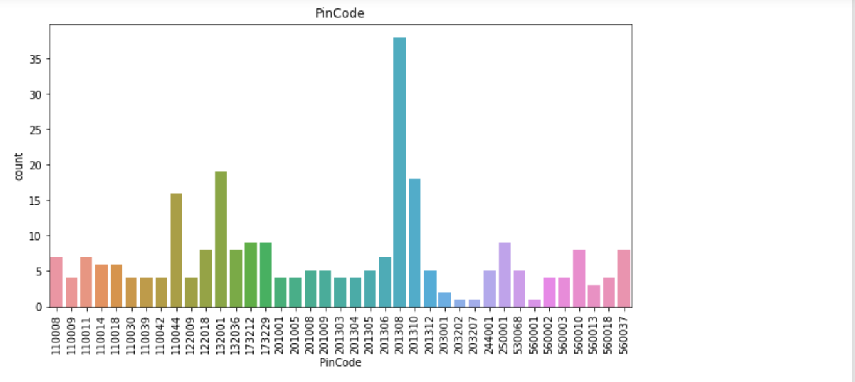
Observations:
The people from pincode: 201308 shop more.

Slide 16
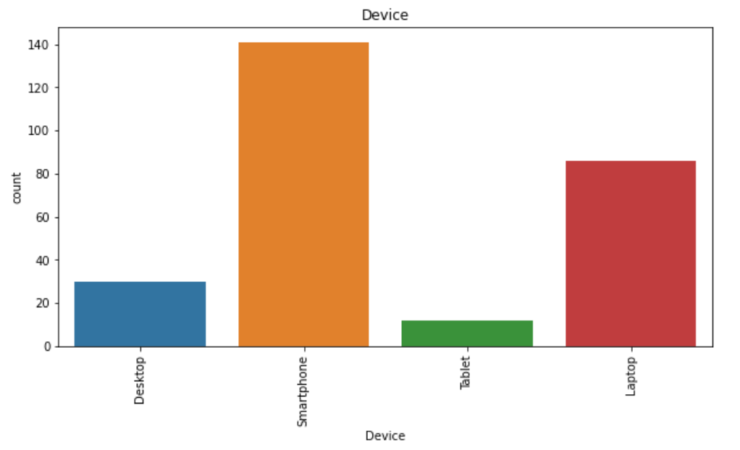
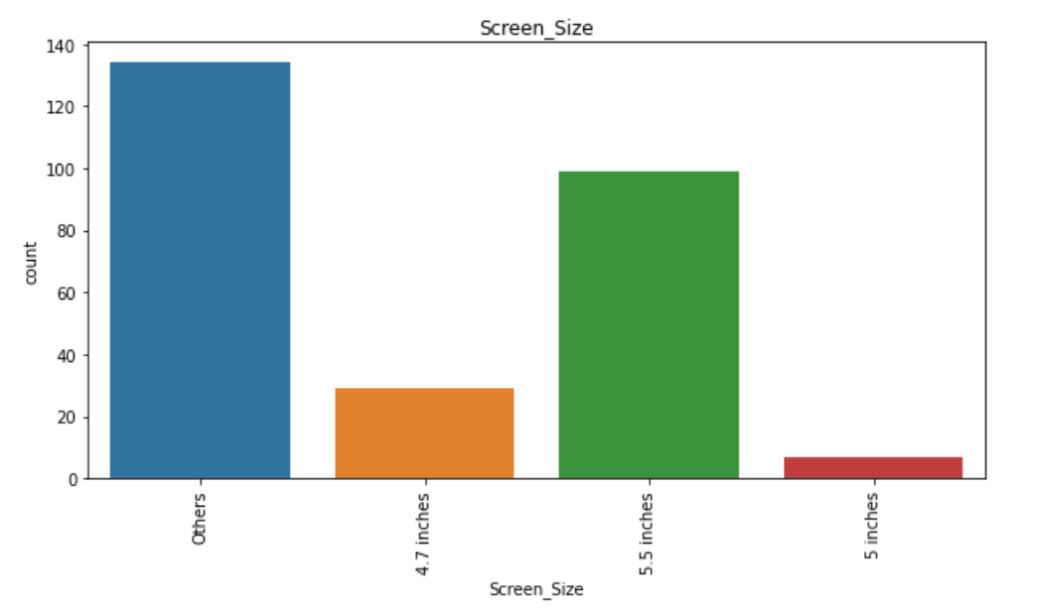
Observations:
Many people make online shopping with Smartphone of minimum 5.5 inches.
Less people uses tablet for online shopping.
Moderate people uses laptop and desktop.

Slide 17
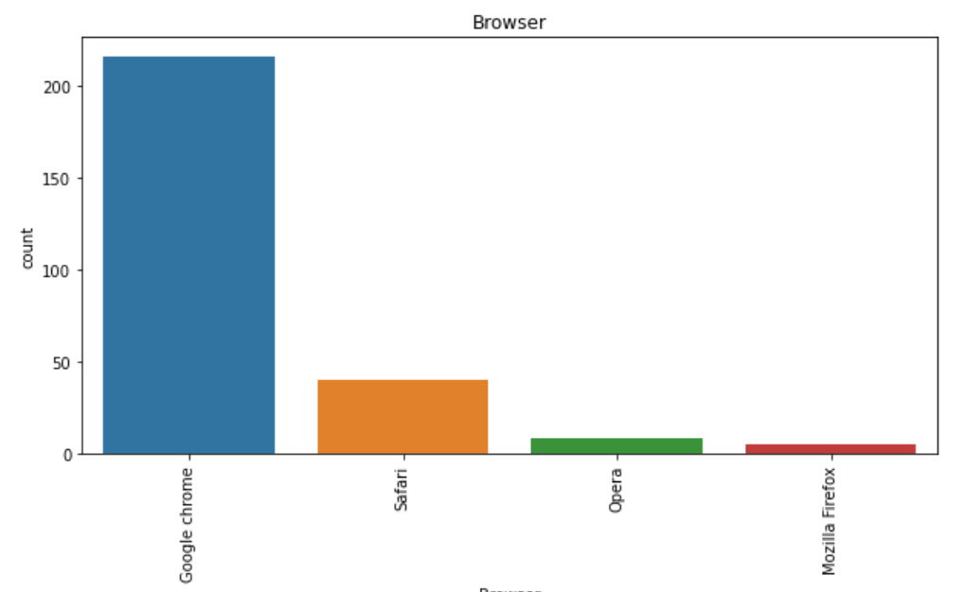
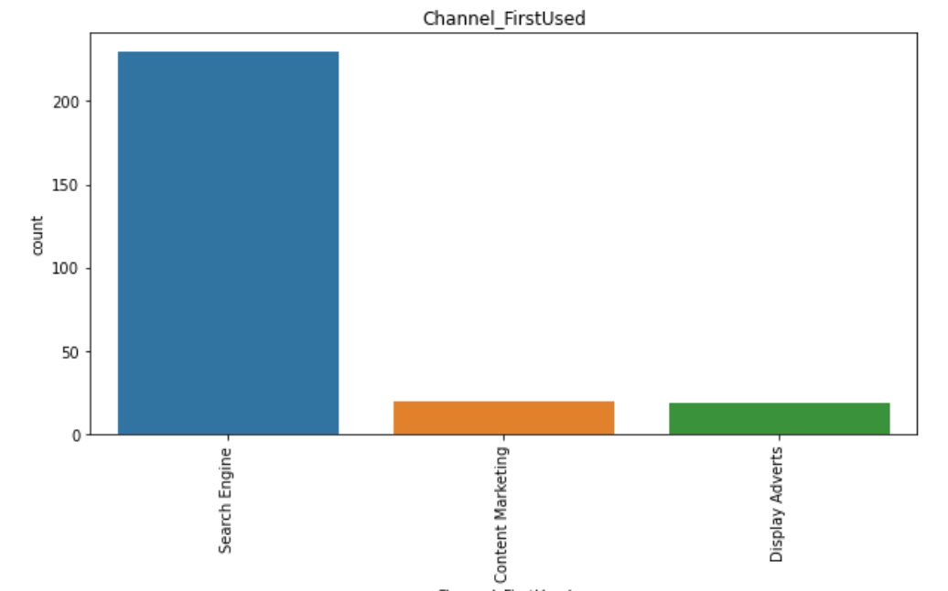
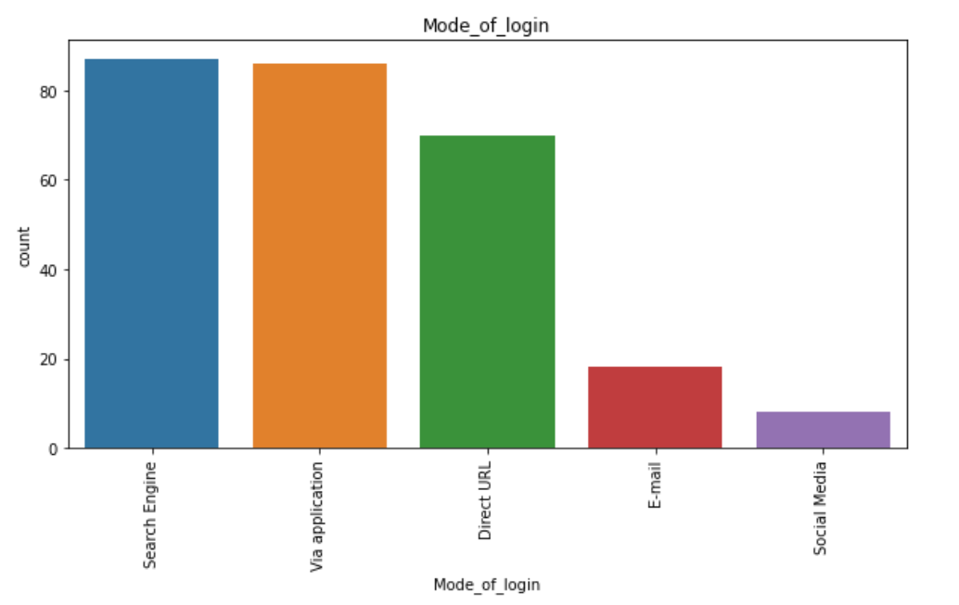
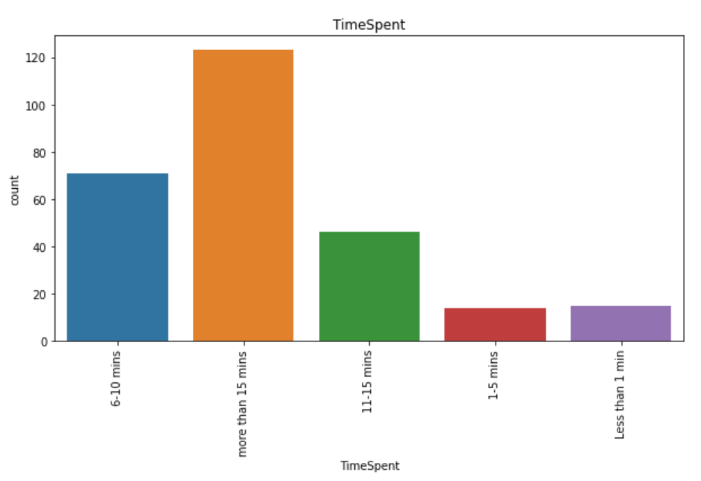

Slide 18
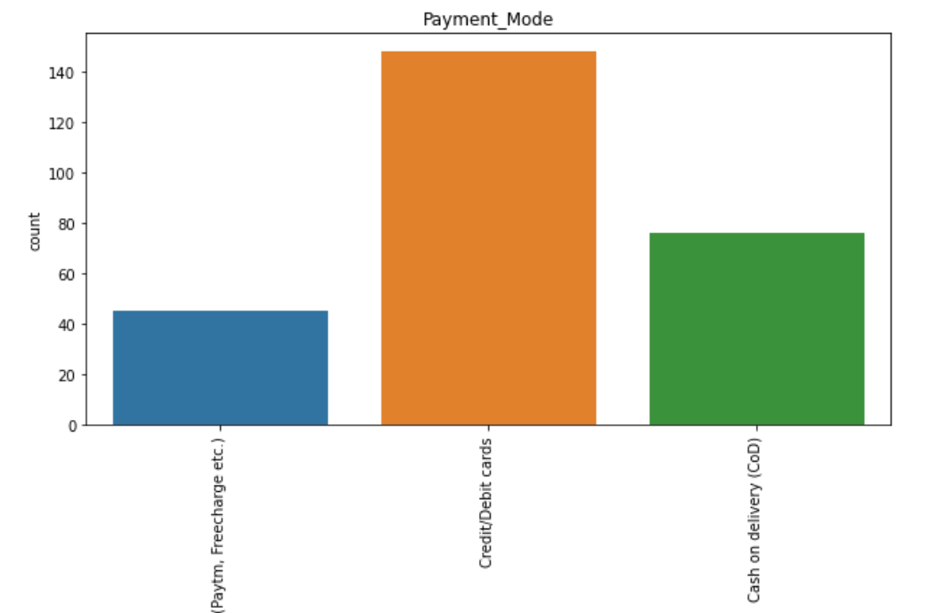
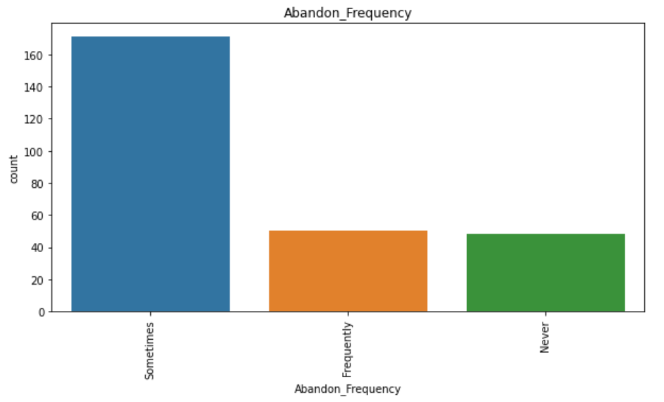
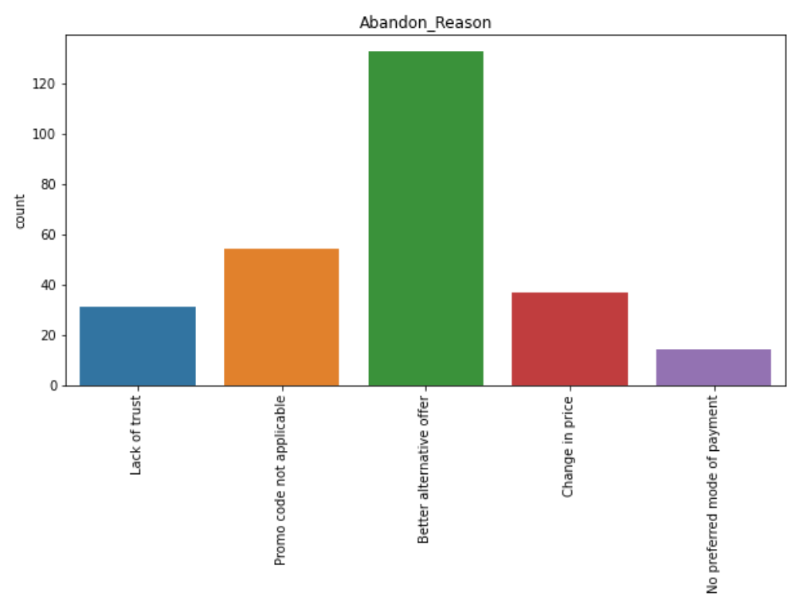
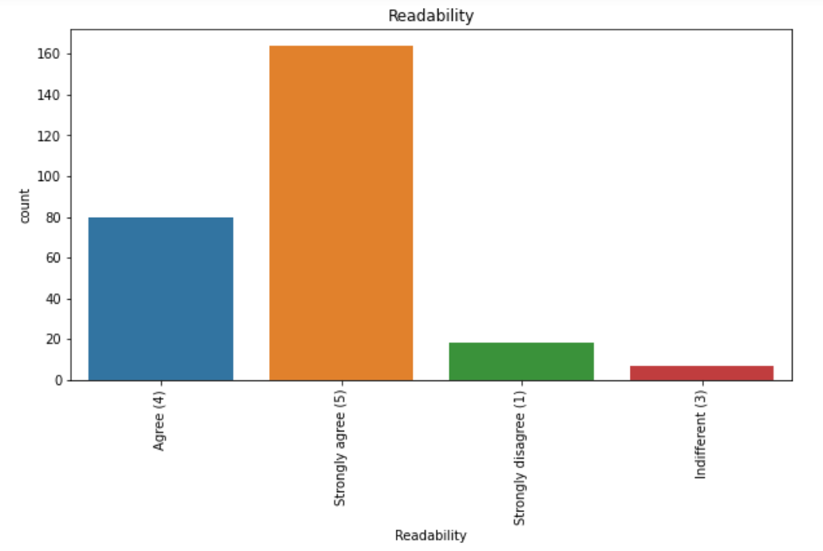

Slide 19
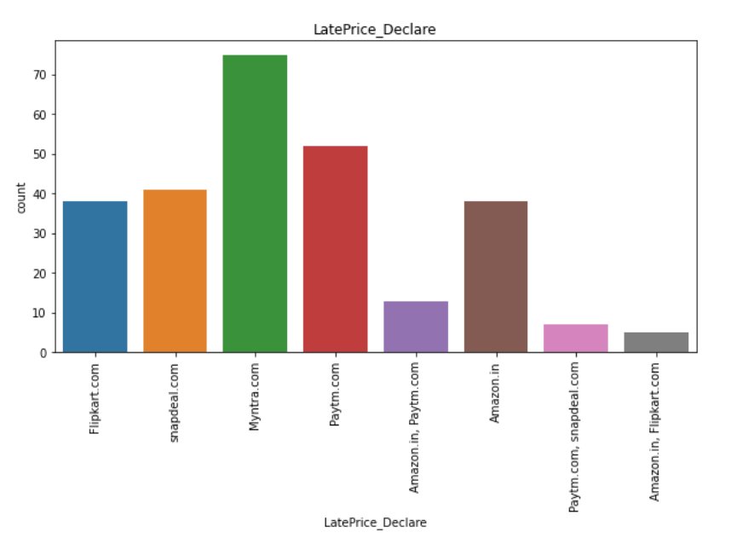
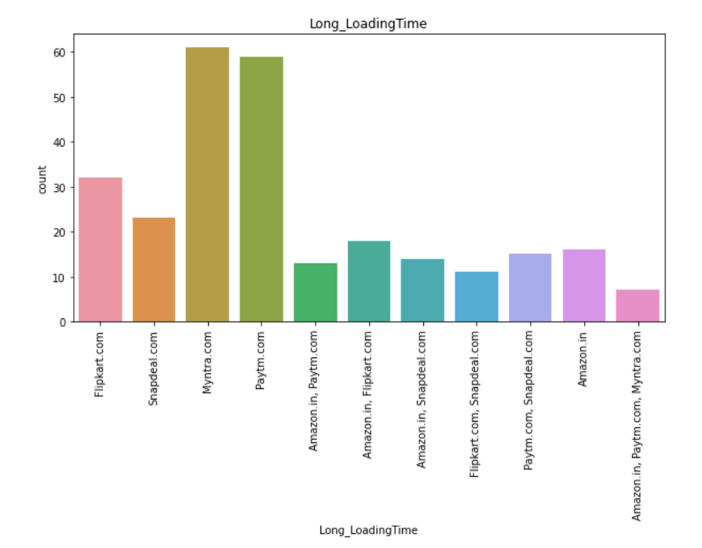
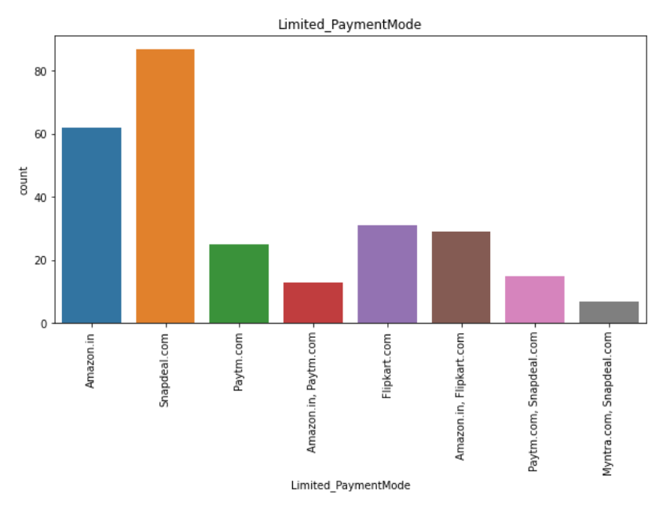
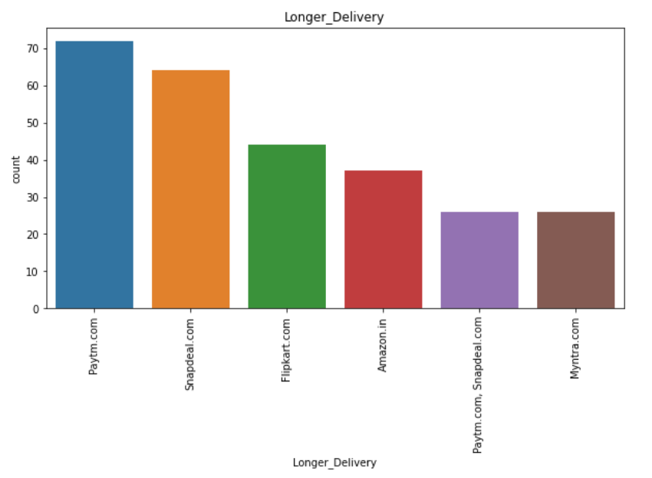

Slide 20
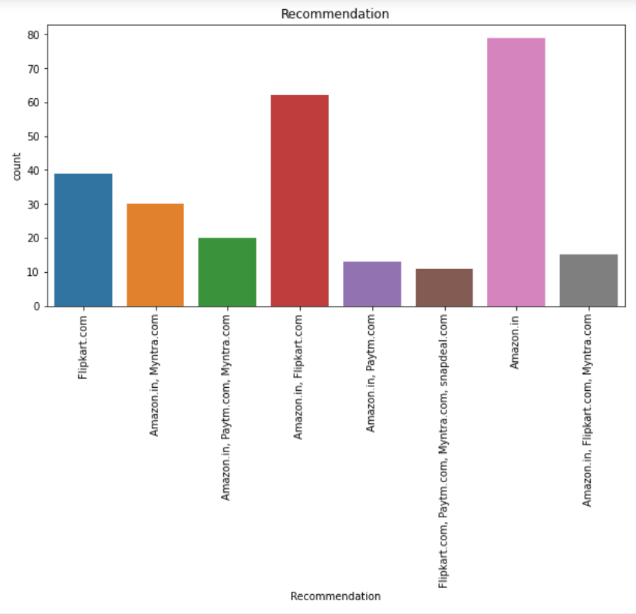
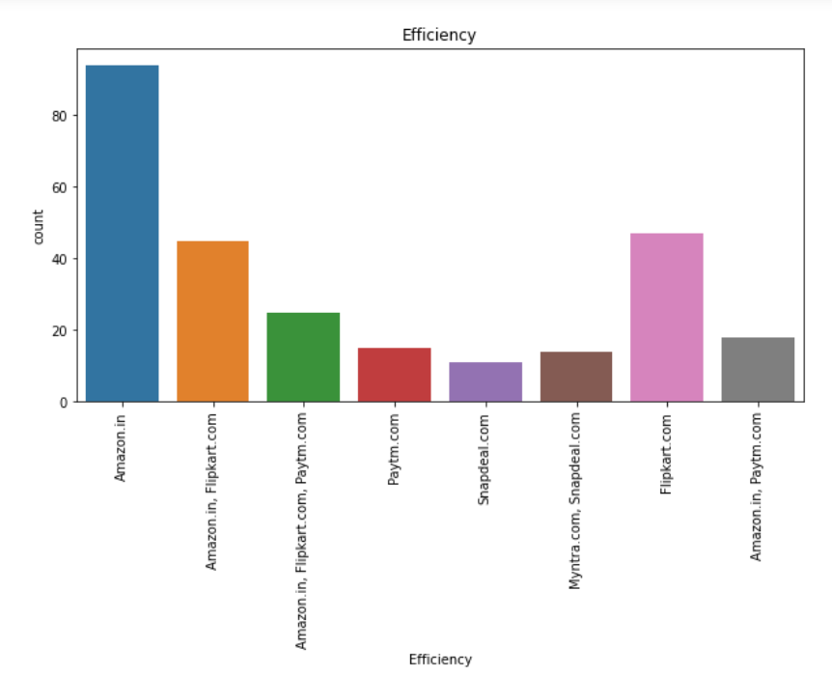

Slide 21
Observations from Univariate Analysis:
Female customers are more than Male customers.
According to 'Age' 31 to 40 years Old shops more and 51 years above shops less.
Delhi has maximum count of customers.
The people from 201308 pincode shop more.
Many people make online shopping with Smartphone and Mobile Internet.
Google chrome is the people's favourite browser for online shopping.
Many People Strongly Agree with the customer_Privacy_Guarantee.
Amazon and Flipkart provides complete product info
Amazon is the reliable and fast web app.
Amazon and flipkart has maximum payment options Availability.
Amazon makes fastest delivery among all other shopping sites.
Myntra and Paytm takes longer to load.
Snapdeal has limited payment mode.
Paytm takes longer delivery time.
Amazon.in has good efficiency.
Mostly People recommends shopping from "Amazon.in"

Slide 22
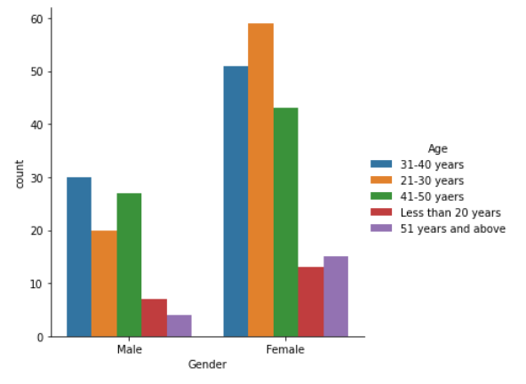
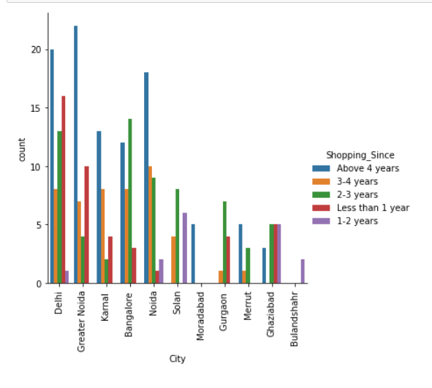
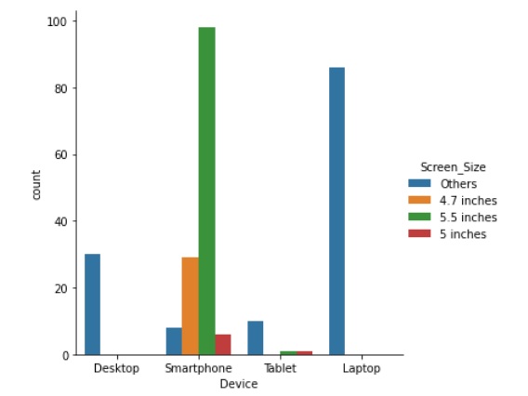
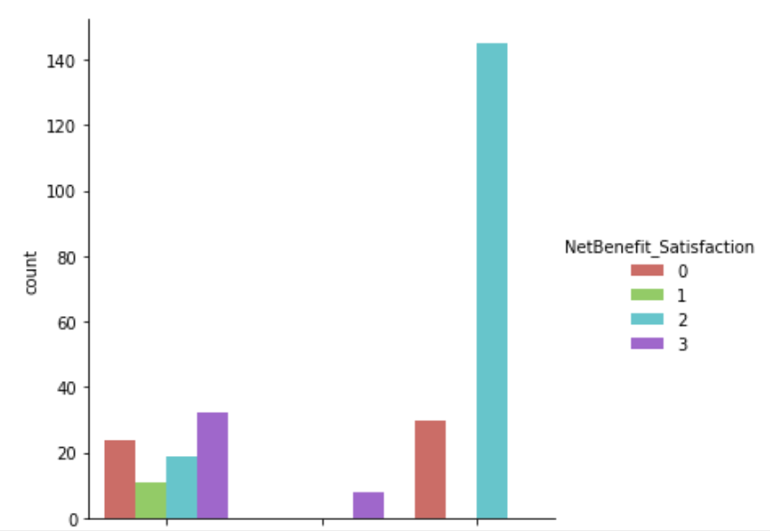

Slide 23
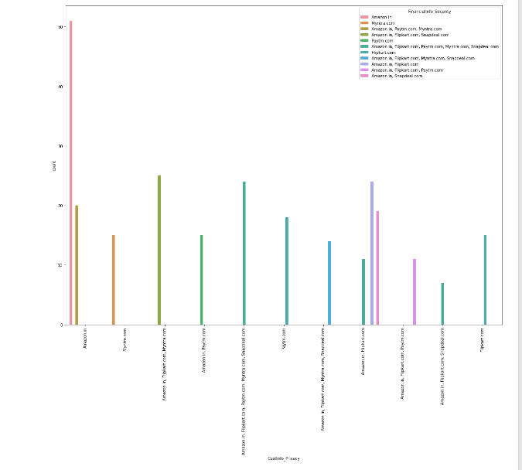

Slide 24
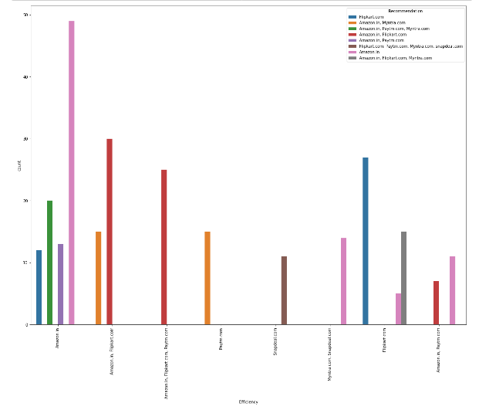

Slide 25
Observations from Bivariate Analysis:
Males of Age 31-40 years shop more than the females belonging to same age group.
Many customers don’t abandon frequently, but the reason for Abandon is “Better Alternative Offer”.
From the visualizations we can clearly understand that customer wants user friendly interface,convenient and variety of payment methods.
Maximum customers agrees that that online shopping gives good discounts.
Maximum number of customers uses debit/credit cards for payment.
Maximum customers are satisfied with the services offered by Amazon apart from few drawnbacks.
Apart from few drawbacks flipkart is also great choice for many customers.
Paytm has good trustworthiness and security but lacks with fast delivery and discounts.

Slide 26
CONCLUSION:
High customer retention and Satisfaction:
Amazon.in
Flipkart.com
High risk of customer churn with:
Myntra.com
Snapdeal.com
Paytm.com

Slide 27
THANK YOU

